Slide 1

What the rent?
Barcelona
How do rent prices relate to geological factors?
Looking at the price distribution, air pollution and noise pollution of rental property locations

Slide 2

“We do not want a Spain of proletariat, but a Spain of [home] owners.”
Jose Luís de Arrese, Spanish Minister of Housing
1957-1960 (De Arrese, 1959)
Sweeney, 2021
Romero, 2020
INE, 2019
Gabinet Tècnic de Programació, 2016

Slide 3
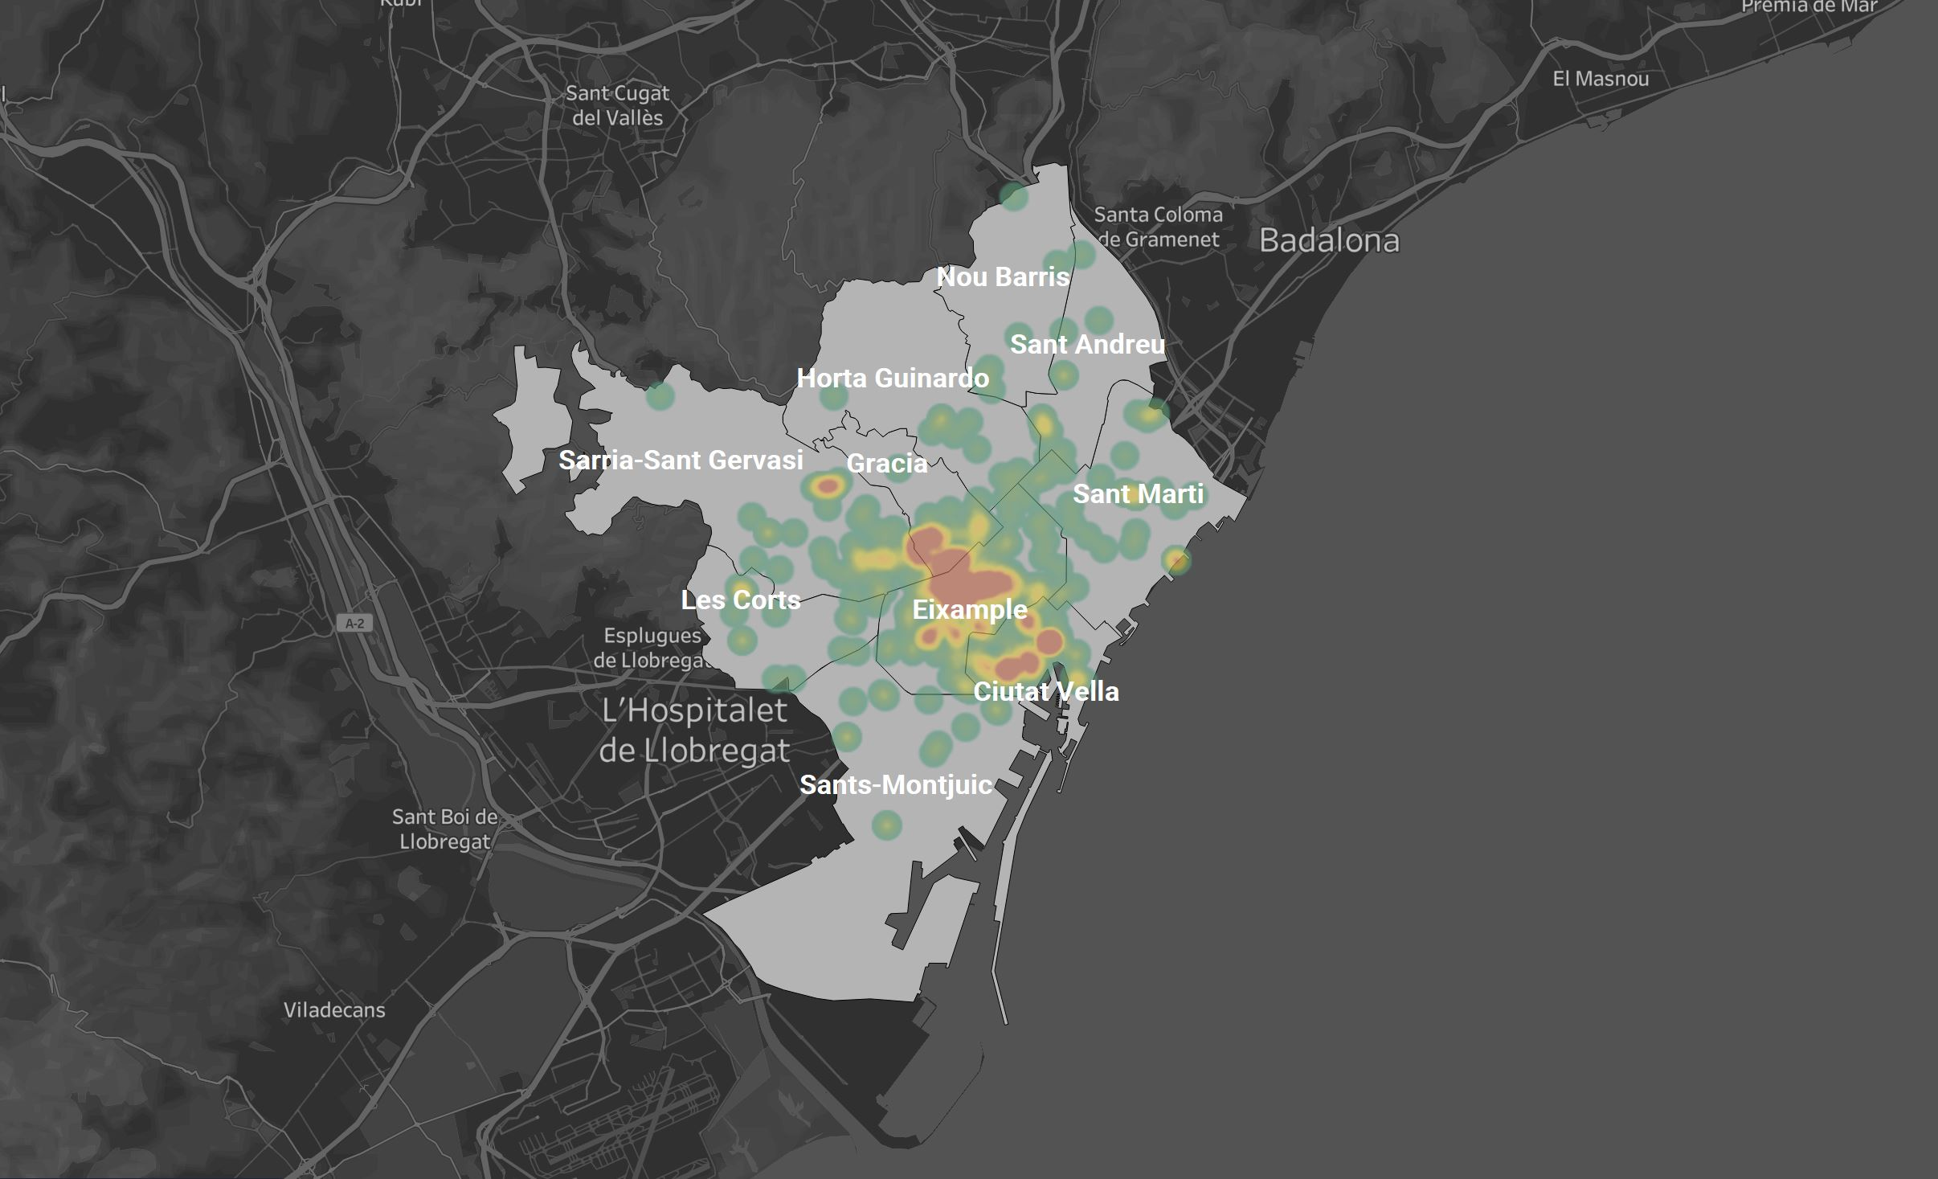
Distribution of rent price

Slide 4

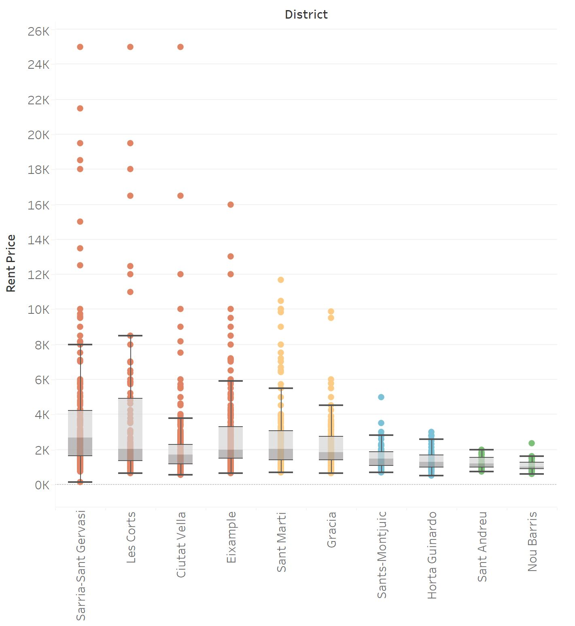

Slide 5
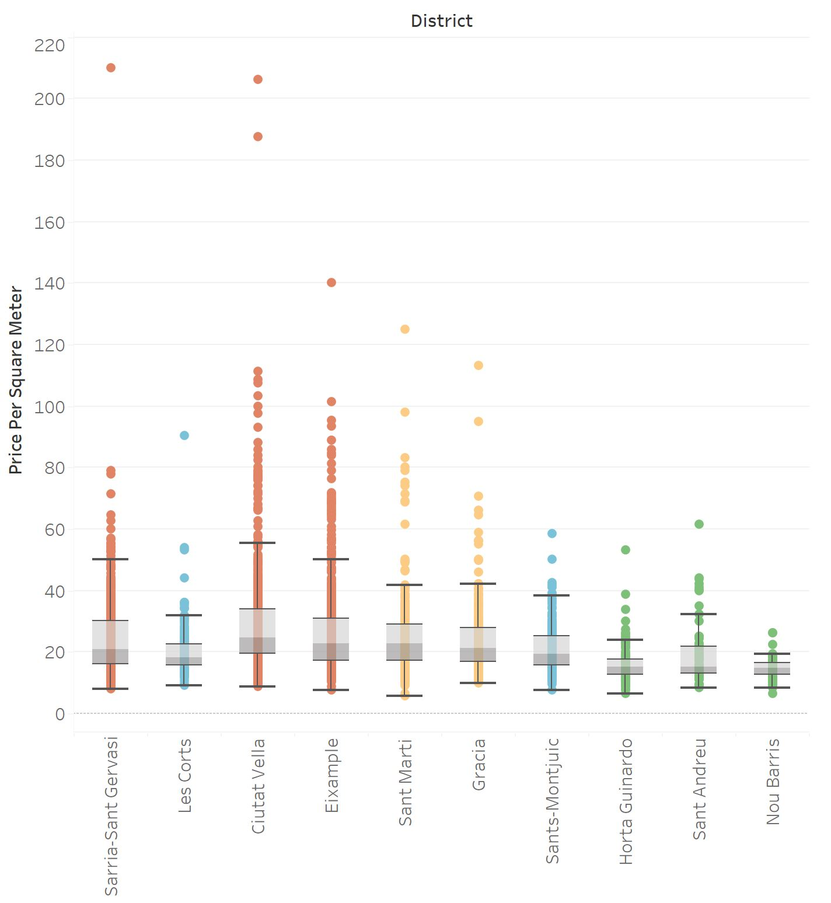

Slide 6
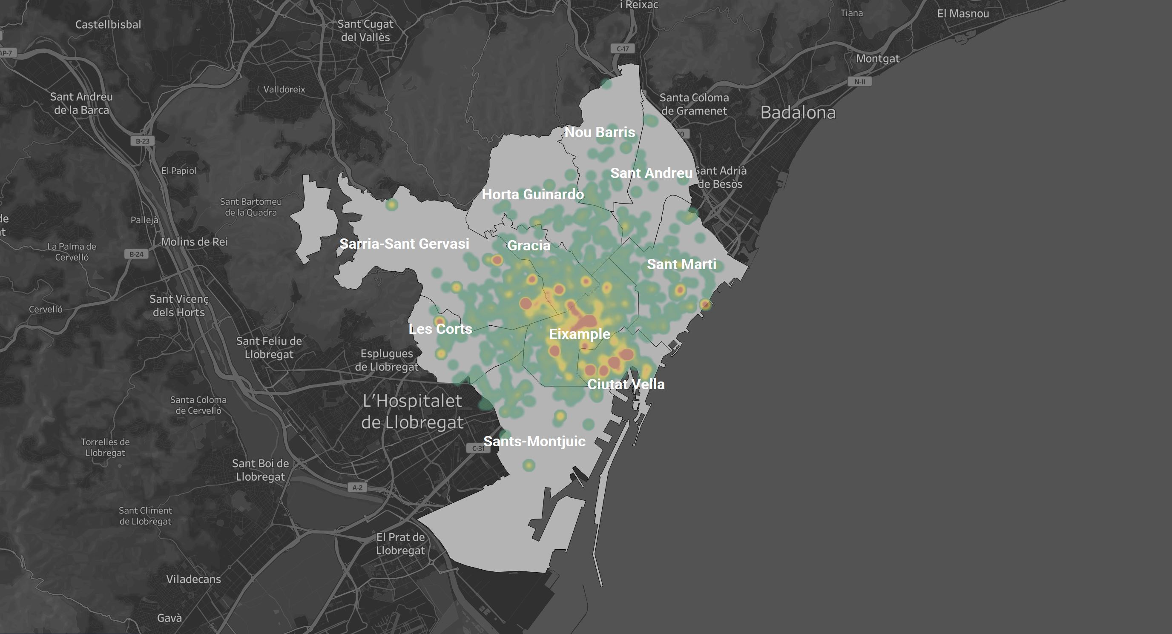
Distribution of price/m²

Slide 7

Sarria-Sant Gervasi
2952 €
25 €
129 m²
41 µg/m²
69 dB
Mean Rent
Mean price/m²
Mean
Mean NO2
Mean noise

Slide 8
Ciutat Vella
1728 €
28 €
66 m²
42 µg/m²
64 dB
Mean Rent
Mean price/m²
Mean
Mean NO2
Mean noise

Slide 9
Eixample
2470 €
26 €
99 m²
56 µg/m²
72 dB
Mean Rent
Mean price/m²
Mean
Mean NO2
Mean noise

Slide 10

Nou Barris
1061 €
14 €
Mean Rent
Mean price/m²
76 m²
Mean
32 µg/m²
62 dB
Mean NO2
Mean noise

Slide 11
Sant Andreu
1274 €
22 €
Mean Rent
Mean price/m²
67 m²
Mean
36 µg/m²
65 dB
Mean NO2
Mean noise

Slide 12
Distribution of price/m²

Slide 13
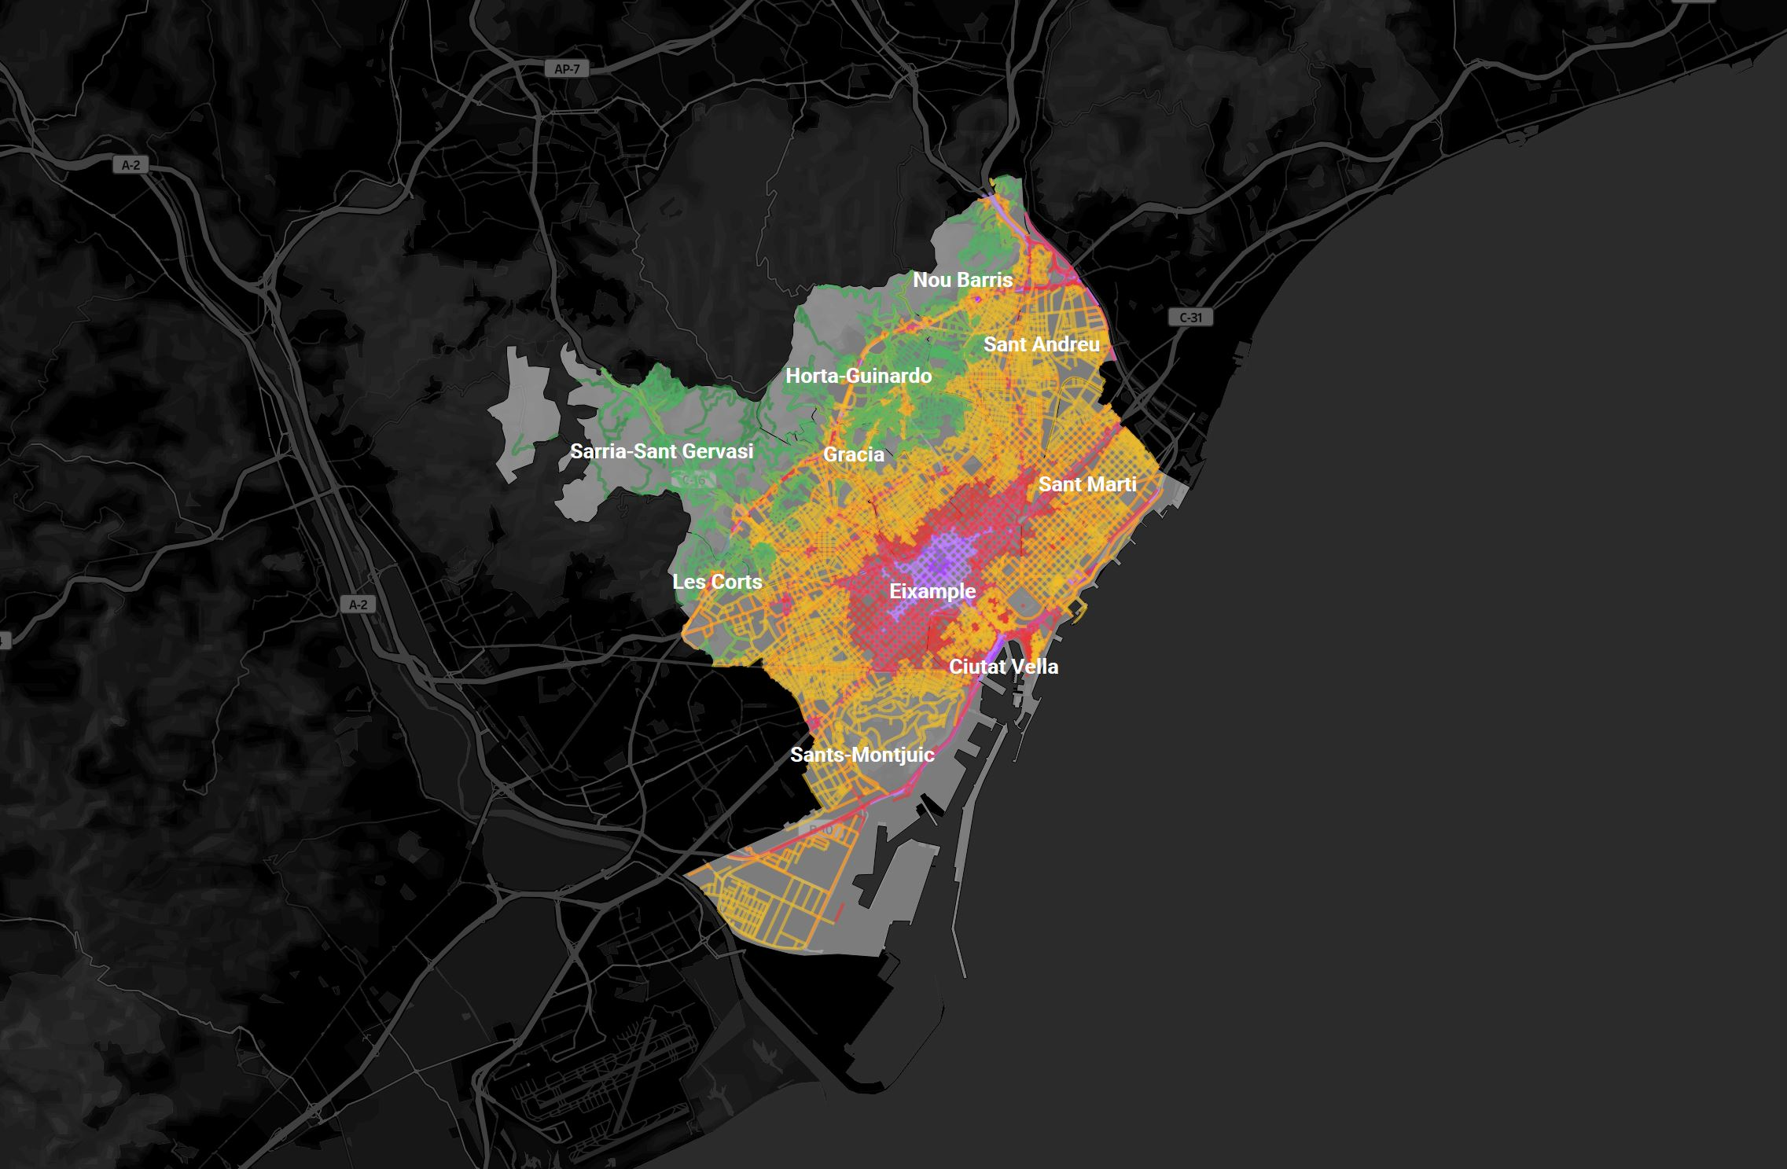
Air pollution (NO2)

Slide 14
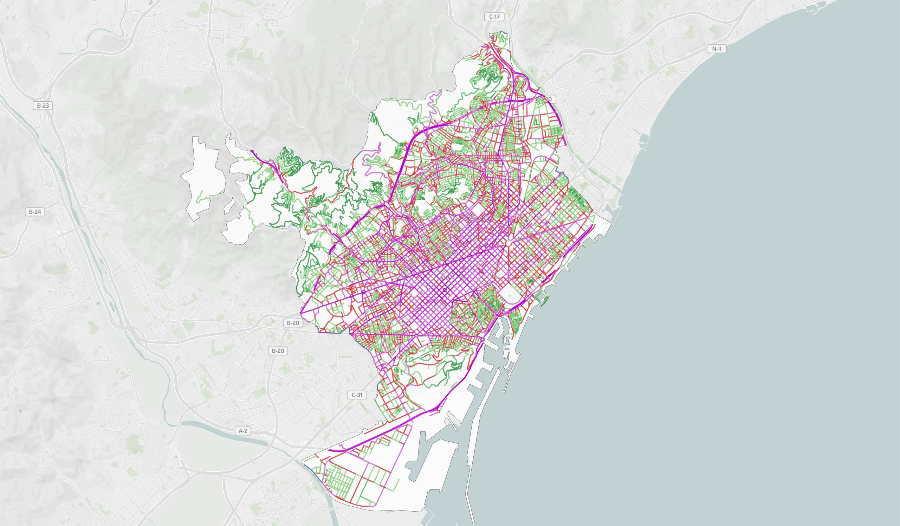
Noise levels during the day

Slide 15
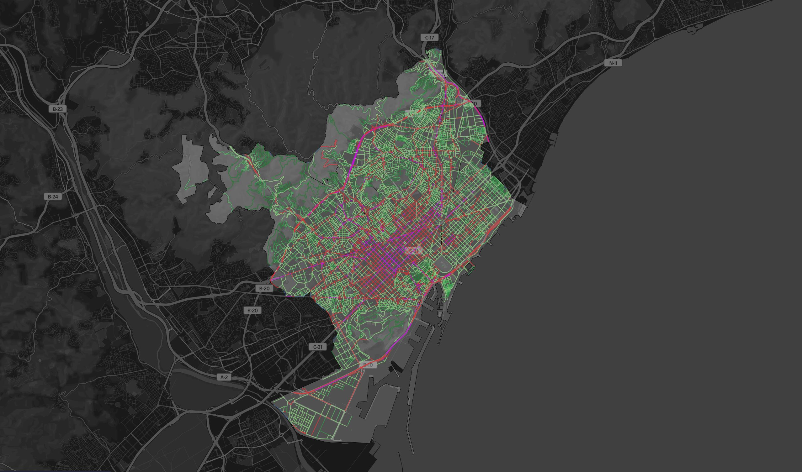
Noise levels at night

Slide 16
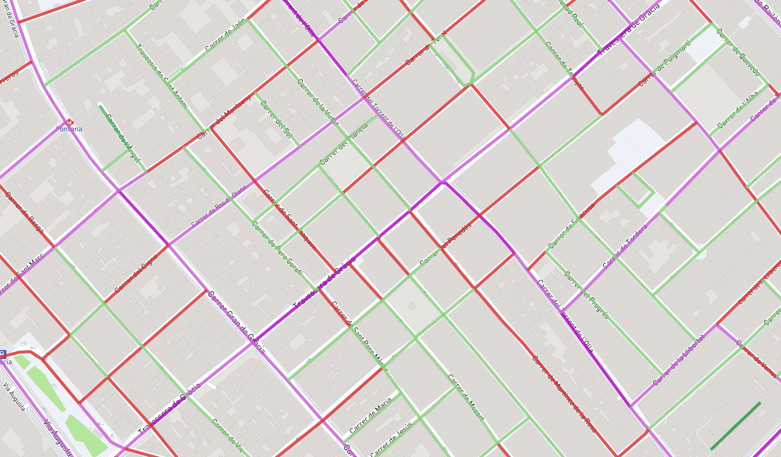
Noise levels during the day

Slide 17
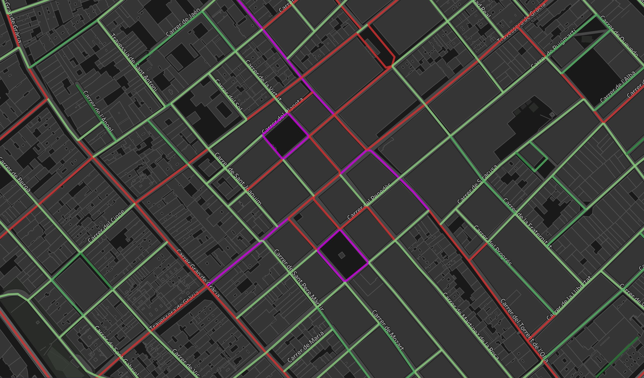
Noise levels at night

Slide 18
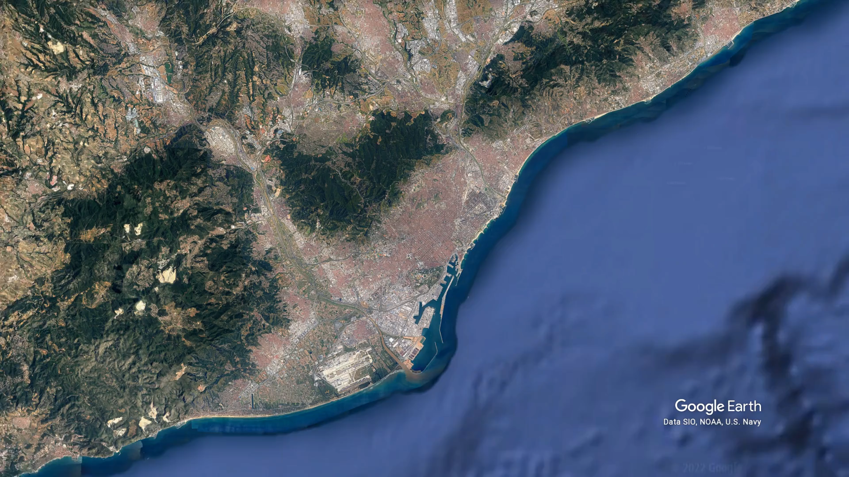

Slide 19

Now what?
Searching for a flat is easier when you know what you care for in daily life.
And often a trade-off.
Easy access to activities and public transport?
Little noise and clean air?
Bigger flat but further away?

Slide 20
Also …
Look at the smaller scale.
How is the immediate neighborhood?
Day and night?
Can you find exceptions to the rule?

Slide 21

Questions?

